Slide 1


Parallel and Distributed/Cloud Computing
Class: BS(CS)-VIII
Sukkur IBA University – Kandhkot Campus
Week – 05

Slide 2
Recap
Cloud Models
PaaS
IaaS
SaaS

Slide 3
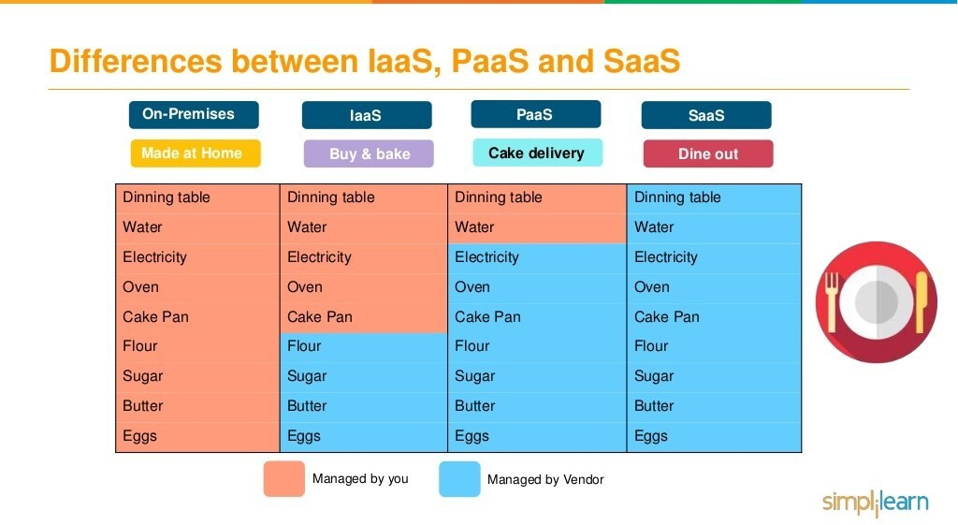

Slide 4
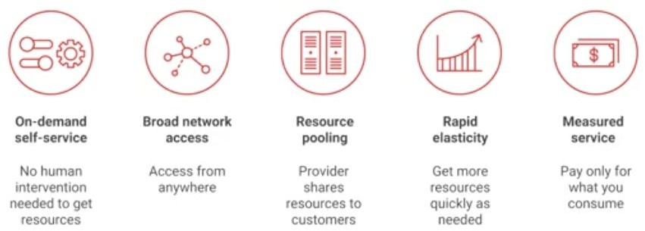
Essentials Characteristics of Cloud Computing

Slide 5
Common Characteristics
Massive Scale
Resilient Computing
Homogeneity
Geographic Distribution
Virtualization
Service Orientation
Low Cost Software
New Cloud Programming Paradigms: MapReduce/Hadoop, NoSQL/Cassandra/MongoDB and many others

Slide 6

Typical Computing Pattern
On & off workloads
Batch jobs
On and Off
Wasted Capacity
Compute
Inactivity Period
Time to market can be cumbersome
Time

Slide 7
Typical Computing Pattern
Rapid Growth
Rapidly growing company
Major challenge for IT dept. to keep up with growth
Potential loss of business opportunity
Potential customer service problems
Compute
Time

Slide 8
Typical Computing Pattern
Unexpected peak in demand
Unpredictable Bursting
Loss of business opportunity
Wasted capacity if demand wanes
Compute
Time

Slide 9
Typical Computing Pattern
Seasonal peaks and troughs
Predictable Bursting
Provisioning dilemma
Wasted capacity or
Loss of business
Compute
Time

Slide 10
Cloud Computing Examples
A large enterprise quickly & economically deploys new internal applications to its distributed workforce.
An e-commerce website accommodates sudden demand for a “hot” product caused by a viral buzz.
A pharmaceutical research firm executes large-scale simulations using computing power provided by cloud vendors.
A media company serves unlimited video, music, and other media to their worldwide customer base.

Slide 11
Cloud Computing Nutshell
End-users connect over the Internet to the cloud from their own personal computers or portable devices in order to access services.
To the end-user, the underlying infrastructure such as the hardware, operating system, etc., is invisible
Servers
Laptops
Desktop
Application Platform Infrastructure
Phones
Tablets
Cloud Computing

Slide 12
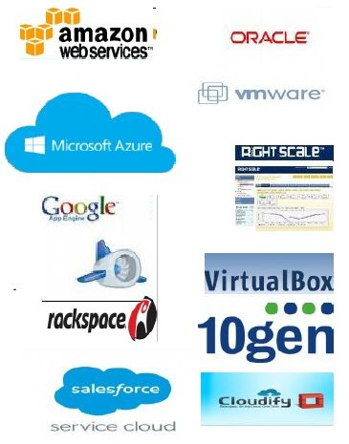
Many Cloud Providers
AWS: Amazon Web Services
EC2: Elastic Compute Cloud
S3: Simple Storage Service
EBS: Elastic Block Storage
Microsoft Azure
Google Compute Engine/AppEngine
Rightscale, Salesforce, EMC,
Gigaspaces, 10gen, Datastax, Oracle,
VMWare, Yahoo, Cloudera
And 100s more…

Slide 13
Cloud-Sourcing
Why is it becoming important?
Using high-scale/low-cost providers,
Any time/place access via web browser,
Rapid scalability; incremental cost and load sharing,
Can forget need to focus on local IT.
Concerns:
Performance, reliability, and SLAs,
Control of data, and service parameters,
Application features and choices,
Interaction between Cloud providers,
No standard API – mix of SOAP and REST!
Privacy, security, compliance, trust…

Slide 14
Advantages of Cloud Computing
Lower computer costs
No need of a high-powered and high-priced computer to run cloud computing's web-based applications
Improved performance
Cloud computing system boot and run faster because they have fewer programs and processes loaded into memory
Reduced software costs
No need to purchase expensive software applications

Slide 15
Advantages of Cloud Computing
Instant software updates
Unlimited storage capacity
Increased data reliability (crash of hard drive destroy valuable data)
Universal information access
Latest version availability
Easier group collaboration
Device independence

Slide 16
Disadvantages of Cloud Computing
Requires a constant internet connection
Does not work well with low-speed connections
Features might be limited
Application Can be slow
Stored data might not be secured
Stored data can be lost!
Not clear that you can run compute-intensive HPC applications that use MPI/OpenMP
General Concerns
Each cloud systems uses different protocols and different APIs
may not be possible to run applications between cloud based systems
Amazon has created its own DB system (not SQL 92), and workflow system (many popular workflow systems out there)
so your normal applications will have to be adapted to execute on these platforms.

Slide 17
Thank you!
Any Questions???
49

